Slide 1
The Introduction and Evaluation of FIT
James Turvill
October 2019

Slide 2
Faecal Immunochemical Test for haemoglobin
FIT
  BCSP
    Asymptomatic screening
    60-74years
    Cut-off 120µg Hb/g faeces
  2ww patients for suspected colorectal cancer
    Research
  Patients at low risk for colorectal cancer
    NICE DG30

Slide 3
Faecal Immunochemical Test for haemoglobin
FIT
  BCSP
    Asymptomatic screening
    60-74years
    Cut-off 120µg Hb/g faeces
  2ww patients for suspected colorectal cancer
    Research
  Patients at low risk for colorectal cancer
    NICE DG30

Slide 4
Indications for use of FIT in DG30
People:
without rectal bleeding
who have unexplained symptoms that do not meet the criteria for a suspected cancer pathway
REPLACES
People:
>50yrs with unexplained
  abdominal pain
  weight loss
<60yrs with
  changes in their bowel habit
  iron-deficiency anaemia
>60yrs with anaemia even in the absence of iron deficiency

Slide 5
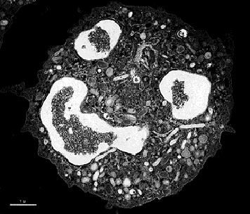
Faecal Calprotectin
IBS v IBD
use in adults
new lower gastrointestinal symptoms
cancer is not suspected
NICE DG11

Slide 6
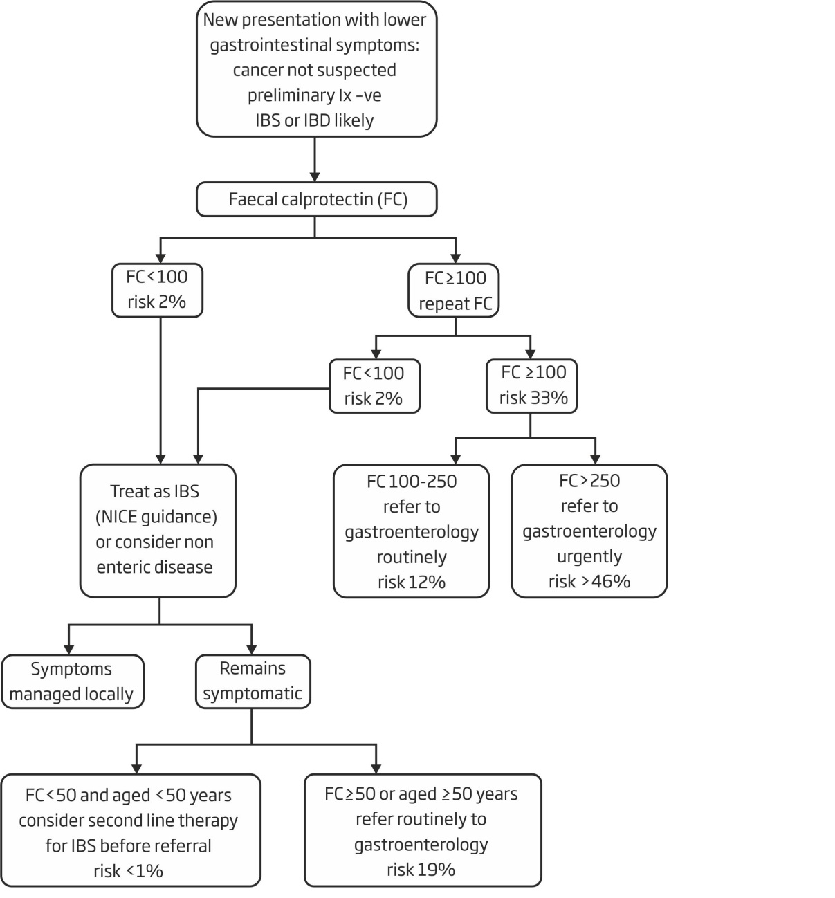

Exclusion criteria:
Cancer suspected (NICE guideline NG12. https://www.nice.org.uk/guidance/ng12)
Inclusion criteria:
Adult 18-60 years
New lower gastrointestinal symptoms
Norma or negative initial workup (FBC,U&E,Cr,TFT,CRP,Ca, coeliac screen)
Stool culture / C. difficile screen as appropriate

Slide 7

YFCCP economic evaluation
Health economic evaluation with YHEC
Outcome data compared against historic standard care, predicted outcomes from FC usage and outcomes from this implementation using standard cut off (per 1000 pts)

Slide 8



FIT NICE DG30:
FIT for low risk patients
How does it fit with FC?

Slide 9

FIT NICE DG30:
FIT for low risk patients

Slide 10
FIT NICE DG30:
FIT for low risk patients
?

Slide 11
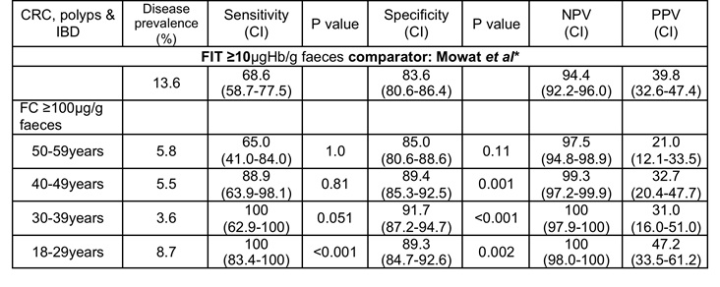
FIT or FC?

Slide 12
Roll out of FIT: the challenges
Introduce FIT
Evaluate FIT
Compare the effectiveness of FC and FIT
18-59 years
FC v FIT
YFCCP + FIT
not high risk for CRC (2ww)
baseline investigations normal
diagnostic uncertainty
not isolated rectal bleeding
FC and FIT
≥60 years
not high risk for CRC (2ww)
abdominal pain
weight loss
anaemia in the absence of iron deficiency
FIT

Slide 13
Diagnostic accuracy study: 1
Patient presents with possible lower gastrointestinal disease
Baseline assessment and investigations as appropriate
  FBC, CRP, ferritin, TFT, coeliac screen
  Stool culture, C.difficile toxin
Not 2ww for cancer
Diagnostic uncertainty
Not isolated rectal bleeding: surgical referral

Slide 14

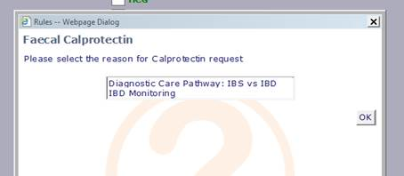
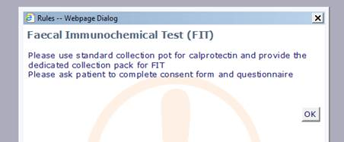
Patient 18-59yrs
Only Calprotectin available to request
Question to prompt GP to request FC for:
Diagnostic care pathway: IBS v IBD
IBD monitoring
If you tick ‘IBS v IBD’ FIT auto requested
This “Help” prompt appears to help:
universal pot
and FIT pack
If ‘IBD monitoring’: you just get the FC

Slide 15
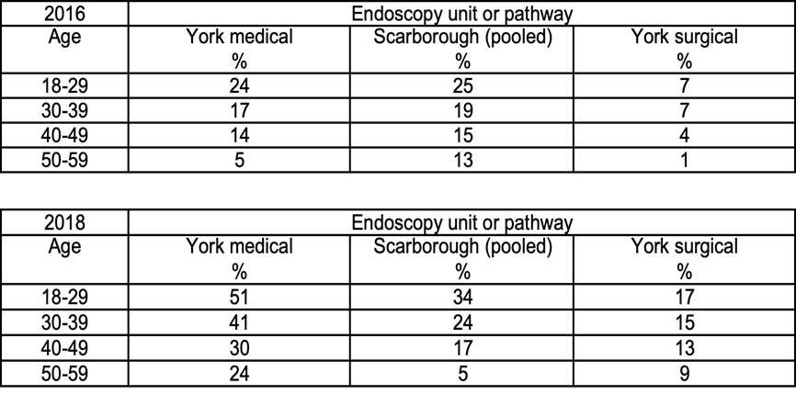
YFCCP requests and referrals

Slide 16
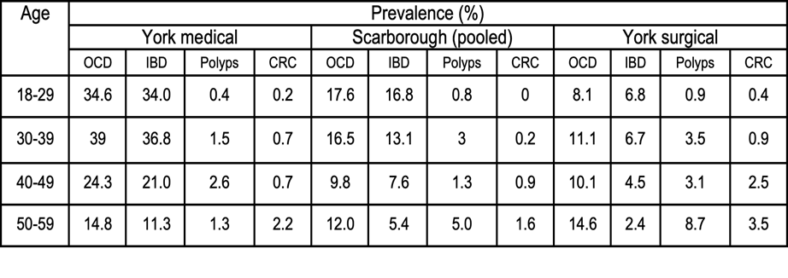
YFCCP prevalence of disease
Prevalence of organic colonic disease: IBD, significant polyps and colorectal cancer by age and referral/endoscopic pathway.

Slide 17
Suspecting cancer….. how to interpret 1.3.3
consider a suspected cancer pathway referral for colorectal cancer in adults
  < 50y with rectal bleeding & unexplained:
    abdominal pain
    change in bowel habit
    weight loss
    iron‑deficiency anaemia

Slide 18

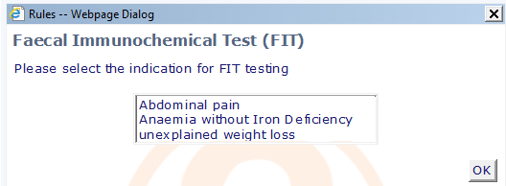
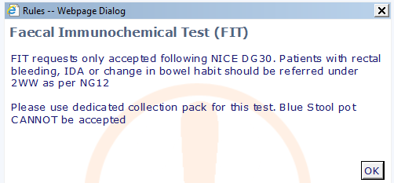

Patient ≥60yrs
Both tests available to request if needed
Choose an option in order to proceed.
FIT test selected - this pop-up box appears
One of the top three options selected:
This pop-up box then appears
Calprotectin cannot be co-requested with FIT

Slide 19
Diagnostic accuracy study: 2
18-59 years: option to request FC
  ICE will ask then you to request FIT
≥60 years: option to request FIT
  Specific indications for referral
Patient pack
  Information sheet
  Patient questionnaire
  Consent form
  FIT picker
  Instructions for use
  SAE
Universal container (blue top)
Conventional (safety netted) follow up with results

Slide 20
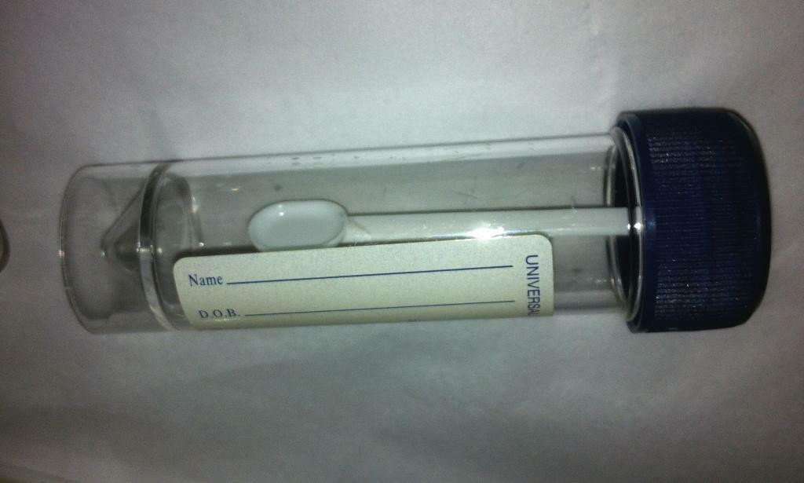
FC needs a universal pot

Slide 21
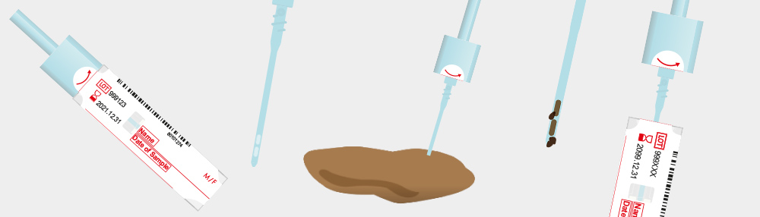
FIT needs a picker

Slide 22
FIT needs a picker
What the patient needs to do:
Name
Date of birth
Date of sampling

Slide 23
Diagnostic accuracy study: 3
≥60 years:
FIT positive: 2ww colorectal referral
FIT negative: reassure colorectal cancer very unlikely
  treat symptomatically and review
  routine referral or consider uro-gynaecological disease
18-59 years:
follow the YFCCP
FC <100: IBS likely
FC ≥100: repeat
  repeat FC <100: IBS likely
  repeat FC 100-250: routine gastroenterology referral
  repeat FC >250: STT colonoscopy/urgent gastroenterology referral
IF FC <250 ON COMPLETION OF YFCCP
BUT ANY FIT IS POSITIVE:
2WW COLORECTAL REFERRAL

Slide 24
Exclusion criteria:
Cancer suspected (NICE guideline NG12. https://www.nice.org.uk/guidance/ng12)
Inclusion criteria:
Adult 18-60 years
New lower gastrointestinal symptoms
Norma or negative initial workup (FBC,U&E,Cr,TFT,CRP,Ca, coeliac screen)
Stool culture / C. difficile screen as appropriate

Slide 25
FIT+ve: 2WW
Exclusion criteria:
Cancer suspected (NICE guideline NG12. https://www.nice.org.uk/guidance/ng12)
Inclusion criteria:
Adult 18-60 years
New lower gastrointestinal symptoms
Norma or negative initial workup (FBC,U&E,Cr,TFT,CRP,Ca, coeliac screen)
Stool culture / C. difficile screen as appropriate

Slide 26
FIT+ve: 2WW
FIT+ve: 2WW
Exclusion criteria:
Cancer suspected (NICE guideline NG12. https://www.nice.org.uk/guidance/ng12)
Inclusion criteria:
Adult 18-60 years
New lower gastrointestinal symptoms
Norma or negative initial workup (FBC,U&E,Cr,TFT,CRP,Ca, coeliac screen)
Stool culture / C. difficile screen as appropriate

Slide 27
FIT+ve: 2WW
FIT+ve: 2WW
FIT+ve: 2WW
Exclusion criteria:
Cancer suspected (NICE guideline NG12. https://www.nice.org.uk/guidance/ng12)
Inclusion criteria:
Adult 18-60 years
New lower gastrointestinal symptoms
Norma or negative initial workup (FBC,U&E,Cr,TFT,CRP,Ca, coeliac screen)
Stool culture / C. difficile screen as appropriate

Slide 28
Diagnostic accuracy study: 4
GP management/referral guidance will be provided by the laboratory to accompany the FC/FIT result
GP information sheet
Training video
‘FIT positive indication for referral’ will be added to the 2ww for suspected colorectal proforma
Safety netting
Data collection

Slide 29
Expected outcomes
≥60 years:
  numbers?
  FIT positive: 10%
  significant disease: 50%
18-59 years:
  numbers?
    current YFCCP requests: 4000/year
    FC requests as a proportion of referrals: 15%
  FC positive: 15%
    FC>250 significant disease: 50%
  FIT positive and FC negative: 5%
    significant disease: 60%
  numbers needed to diagnose significant disease
    YFCCP: 3.8
    No YFCCP: 6.8
  FC/FIT negative: follow the YFCCP
    reassure, treat and review

Slide 30
Thank you
Any queries, contact me:
James.Turvill@York.NHS.UK
01904 725480

