Slide 1
Special Educational Needs and Disability (SEND) Training
Working effectively together to improve outcomes for children and young people
North Yorkshire and York
Level 2: SEND Training

Slide 2
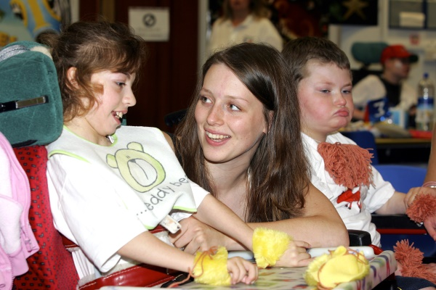
Audience and objectives
This training is for staff who may support Children and Young People (CYP) aged 0-25 years with SEND and their families.
By the end of this training you will understand:
What is meant by SEND and have an awareness of the relevant legislation
Key principles for working with CYP with SEND with a focus on:
Inclusion
Co-production/ personalisation
Advocacy
Key principles which support CYP with SEND:
SEN support
Education, health and care plans
Roles and responsibilities in a multidisciplinary team
Working effectively together to improve outcomes for children and young people

Slide 3
Statue/ Policies/ Guidance
UN Rights of Child
UN Convention on the Rights of Persons with Disabilities
Children and Families Act 2014
SEND Code of Practice 2014
Equality Act 2010
SEND Regulations 2014
Working effectively together to improve outcomes for children and young people

Slide 4
What is SEND?
A child/ young person (CYP) has Special Educational Needs or Disability (SEND) if:
A child has a learning difficulty or disability if they:
have significantly greater difficulty in learning than the majority of others the same age.
OR
have a disability which prevents or hinders them from making use of facilities of a kind generally provided for others of the same age in mainstream schools or mainstream post-16 institution.
they have a learning difficulty or disability which calls for special educational provision to be made for them.
(SEND Code of Practice 2015)
Working effectively together to improve outcomes for children and young people

Slide 5
Learning difficulty or learning disability?
The terms learning disability and learning difficulty are often used interchangeably, however they do have a slightly different meaning.
Mencap share a detailed description of learning disabilities and learning difficulties :-
It states that: “A learning disability is a reduced intellectual ability and difficulty with everyday activities – for example household tasks, socialising or managing money – which affects someone for their whole life. People with a learning disability tend to take longer to learn and may need support to develop new skills, understand complicated information and interact with other people.”
A learning difficulty is different from a learning disability because a learning difficulty does not affect general intellect. There are various types of learning difficulty, for example, dyslexia, dyspraxia or attention deficit-hyperactivity disorder (ADHD). An individual can have one, or a combination. Both learning disability and learning difficulties can exist on a scale.
Working effectively together to improve outcomes for children and young people

Slide 6
Autism Spectrum Condition (ASC)
“Autism is a lifelong developmental disability which affects how people communicate and interact with the world.”
(The National Autistic Society website)
For example, people with autism may find bright lights or loud noises overwhelming, stressful, or uncomfortable. As a result, they may get anxious or upset about unfamiliar situations. Autism is a spectrum condition, which means people with autism may have varying support needs. Additionally, one-third of people with autism also have a learning disability. Importantly, with the right support, most children and young people with learning disabilities, difficulties or autism in the UK will be able to live independent, fulfilling adult lives.
Working effectively together to improve outcomes for children and young people

Slide 7
Thinking about diagnoses
Children and young people with SEND might have a diagnosed condition, or they might not. Some might be waiting for a diagnosis, or concerns might not have been raised yet.
Sometimes, diagnoses can lead us to jump to conclusions about an individual child or young person. We might assume certain things that they can or can’t do, or how we should interact with them.
Working effectively together to improve outcomes for children and young people

Slide 8
Thinking about needs
It is easy to fall back on stereotypes when we see or hear a label. Understanding a child or young person’s needs helps us to think about them as an individual, rather than a ‘type’.
Needs tell us how a child or young person is affected by their condition/s in their day-to-day life. These will differ from person to person.
“Each family and young person will have different diagnoses, different needs, different things they enjoy – please don’t clump us all together”
FLARE member
Working effectively together to improve outcomes for children and young people

Slide 9
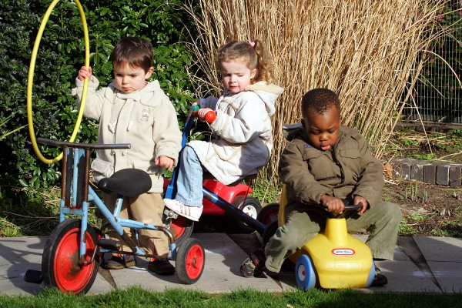
Diagnoses and needs
Diagnosis | Needs
Autism Dysphagia Down’s Syndrome Cerebral Palsy ADHD | Can become distressed with unexpected change Sensory seeking behaviours Low literacy Needs close supervision when eating due to risk of choking Tires easily Unclear speech Low confidence in social situations Low muscle tone
Working effectively together to improve outcomes for children and young people

Slide 10
Changing and emerging needs
We all change with time.
From early childhood we develop new skills, learn new knowledge and understand more about our place in the world.
Children and young people with SEND’s needs can fluctuate more than most. Their development isn’t always linear – new needs may emerge which require further support, or they/their families may develop coping strategies which mean that support can be reduced.
Important:
If a child or young person is doing well, this is likely to be because their needs are being met. It does not necessarily mean that the needs have gone away. This must always be taken into consideration when making decisions about an individual’s support.
Working effectively together to improve outcomes for children and young people

Slide 11
Inclusion
The legislation that you have looked at so far can be brought together under the term inclusion.
Becoming and being inclusive is an on-going journey which we must all take responsibility for. It is not a set list of tasks, but is an ethos which underpins how we interact with others in all contexts.
This video from researcher and teacher Shelley Moore talks about moving from exclusion to inclusion in an education context.
Working effectively together to improve outcomes for children and young people

Slide 12
Perspectives
Members of the FLARE disabled children and young people’s group were asked what inclusion means to them. Here are some of their comments:
Talking to me and listening to me – taking the time. I automatically have double appointments.
When you’re being considered and your thoughts are heard.
Being aware of my other disabilities, not just the bit I’m there to talk about.
It’s an attitude thing and it’s about universal design… not just based off criteria, rather making lives better.
Having the option open so I can manage my health in the way that suits me, which may be different to how a doctor sees it.
Creating an environment which ensures people are able to be themselves and the onus is on people around you to change.
It is breaking down that stigma… my legs might be disabled, but my mind is not.
Working effectively together to improve outcomes for children and young people

Slide 13
The Social Model of Disability
The Social Model of Disability is central to understanding inclusion and being inclusive.
This video from Scope explains the social model from the perspective of disabled people.
As explained by the Alliance for Inclusive Education:
“In the social model of disability, disabled people are seen as being disabled not by their impairments (such as visual impairment or autism) but by society’s failure to take their needs into account. Being disabled is part of the normal spectrum of human life: society must expect disabled people to be there and include us”
Working effectively together to improve outcomes for children and young people

Slide 14
Isolated and Holistic Model
Working effectively together to improve outcomes for children and young people

Slide 15
The SEND jigsaw puzzle!
Creating an inclusive world for children and young people with SEND requires input from all sorts of different people – you hold one piece of the jigsaw.
Who else might have input?
What is your role?
Working together with CYP, families and other ‘pieces of the jigsaw’ as a whole system will support CYP and families to achieve their holistic outcomes.
Working effectively together to improve outcomes for children and young people

Slide 16
Holistic outcomes
Holistic outcomes cannot be achieved by any one type of professional alone, and they are about the big things that matter most to children, young people and their families.
You might use the word ‘outcomes’ slightly differently in your day to day work. In the SEND context, they usually include things like:
Meaningful, healthy relationships
Being and feeling safe
A positive future
Enjoyable, inclusive learning
Good physical and mental health
Fun and leisure opportunities
Working effectively together to improve outcomes for children and young people

Slide 17
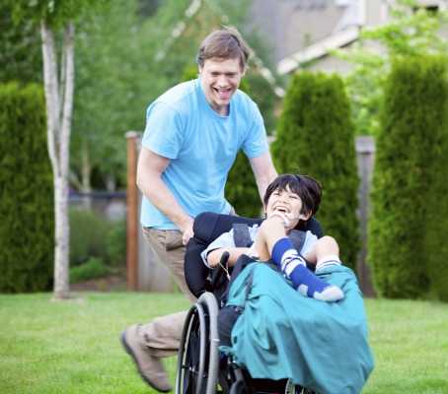
Making outcomes-based decisions
Focusing on outcomes makes sure that professionals focus not just on what they are doing, but what they are achieving. This approach pushes everyone in the system to ask the questions:
Are we achieving the things which matter most to children/young people and families?
Are we making a real difference in children and young people’s lives?
What can we do differently to make more impact?
We can only do this successfully if we work collaboratively, which means bringing professionals across the system together to meaningfully listen and respond to the views and priorities of children, young people and families.
Working effectively together to improve outcomes for children and young people

Slide 18
Working together
In the SEND system, we call working together like this co-production or sometimes participation or joint partnership. It should happen at strategic, operational and individual level.
This video from the Social Care Institute of Excellent (SCIE) summarises co-production.
Locally there is a strong commitment to joint partnership and some Local authorities have coproduced models and strategies for co-production and engagement for example:
Model of Joint Partnership Final September 2020 Audit Version.pdf
(yor-ok.org.uk)
Working effectively together to improve outcomes for children and young people

Slide 19
Being person-centred
Thinking in a way which focuses on outcomes and co-production at the individual level enables professionals to be person-centred. This means putting that particular child or young person’s needs, wishes and preferences (and/ or those of their parent carer) at the centre of their care.
This can mean some difficult conversations about balancing what is:
Best suited to the individual
Most cost-effective
Readily available
Being person-centred is not something that happens now and again, but should run through all of your work.
It also means balancing the opinions of the child or young person, their parent carers and different professionals, which are all valuable but can all differ.
Working effectively together to improve outcomes for children and young people

Slide 20
Being an advocate
An important part of working in a person-centred way is advocating for the child or young person. This essentially means being in their corner by promoting and supporting their views, opinions and what is in their best interest.
This is different from being an official advocate, which is a particular role and may be offered to families by your local SENDIAS service (or an IMCA for a young person over 16 with no close family/ paid supporter).
It is vital that practitioners have an understanding of the Mental Capacity act and the Deprivation of Liberty safeguards within the act. This should be covered in your safeguarding training but here is an NHS link for further information Mental Capacity Act 2005 - NHS (www.nhs.uk)
Working effectively together to improve outcomes for children and young people

Slide 21
Remember!
All children and young people have the legal (Children and Families Act 2014) and moral (UN Convention on the Rights of the Child) right for their views, wishes and feelings to be taken into consideration.
This includes children and young people who are:
Very young
Non-verbal
Non-literate or have low literacy
Take some time to reflect about how a child or young person’s preferences and wishes could be understood, even if they cannot articulate them directly.
Working effectively together to improve outcomes for children and young people

Slide 22
Levels of support
Level | Description
Universal | Services or support which can be accessed by anyone and must make reasonable adjustments for CYP with SEND.
Targeted | Services or support which provide particular support CYP with SEND and their families but can be accessed without a referral
Specialist | Services or support aimed at a specific cohort of CYP with SEND and require an assessment or referral to access
All children and young people with SEND merit a person-centred approach to their support, however this takes place in different ways depending on their level of need. The different levels of support fit under 3 categories. Across is a table outlining the different levels of support available to CYP with SEND and their families.
Working effectively together to improve outcomes for children and young people

Slide 23
Roles and responsibilities for SEND (NHS)
In order to understand health service’s role in SEND it is important to understand how health services are delivered. Services are both:
delivered universally to all – from pre-conception to age 25 years
delivered across a continuum of need. Also known as a graduated approach.
Health service’s graduated approach includes:
Prevention – Public Health approach - aims to reduce the incidence of SEND
Universal Offer – offer made to all CYP / families regardless of need
Early Intervention – when emerging needs are identified
Specialist Assessment & Diagnosis – to determine the need/cause of the need
Therapy, Treatment & Support – to respond to the need/improve outcomes
Different services operate at different levels of the graduated approach
CYP with SEND are a cohort within overall services
Reflect where you and your service fits within this graduated approach.
Working effectively together to improve outcomes for children and young people

Slide 24
Roles and responsibilities for SEND (NHS)
Therapy, Treatment & Support
Assessment & Diagnosis
Early Intervention & Support
Universal Offer
Prevention
Maternity, HV, ScN, GP, Living Well, Genetics, Public Health,
Maternity, HV, Safeguarding Nurse, SEMH Nurse, Primary Care, VIS, Newborn Hearing Screening, Newborn Blood Spot Screening
Maternity, HV, SEMH Nurse, Safeguarding Nurse, Primary Care, SLT, dieticians, OT, Physio, CYPMH, Compass Phoenix/Buzz and Compass, Kooth, Audiology, Ophthalmology
Paediatricians, SLT, OT, Physio, CAMHS, Psychologist, Neuro-Disability Team, Ophthalmology, Audiology, LD Team
Paediatricians, SLT, OT, Physio, CAMHS, Audiology, Ophthalmology, Continuing Health Care, Community Paediatric Nurses, Learning Disability Team, Dieticians, Psychologist, Psychiatrists, Eating Disorder Team, SSN, Looked After Children, Youth Offending Health Team, Care Leavers, Specialist Consultants, Transition Co-Ordinators, Adult Mental Health, Adult Physical Health, Adult Acute Services
Health practitioners/ teams and SEND
Working effectively together to improve outcomes for children and young people

Slide 25
What is an Education, Health and Care plan?
An Education, Health and Care plan (EHC plan) is a legal document which describes a child or young person’s (up to age 25) special educational needs, the support they need, and the outcomes they would like to achieve.
An EHC plan can only be issued after a child or young person has gone through the process of an Education, Health and Care needs assessment and if the support required is above SEN support level that education settings must provide.
Outcomes in EHC plans should be SMART (specific, measurable, achievable, realistic, time-bound).
An outcome can be defined as the benefit or difference made to an individual as a result of an intervention. It should be personal and not expressed from a service perspective; it should be something that those involved have control and influence over.
When writing EHC advice, describing needs is more than a diagnosis, rather what the diagnosis means for the CYP and what interventions need be put in place to address any need arising form a diagnosis.
Information in the plan must be up to date, relevant and pertinent to outcomes. Written so that non-experts understand – no medical jargon.
There is additional annual training for EHCP’s in North Yorkshire and York. The training is available via your manager or by emailing hnyicb-ny.send@nhs.net
Working effectively together to improve outcomes for children and young people

Slide 26
An overview of the process
Deciding Whether to Assess
Some professionals already working with the child or young person might be approached for information on what support is already in place or has been previously tried.
A person-centred conversation with the child, young person and/or parent carers takes place to identify aspirations and the outcomes sought by the individual/ family.
Requesting Advice
Professionals receive the request for advice, along with the aspirations and outcomes sought. Using their expertise and knowledge of the individual, they describe the needs and their impact, comment on the outcomes sought and recommend appropriate provision for achievement of the outcomes.
Professionals identify service-specific targets to sit underneath the holistic outcomes.
Assessment and Evidence Gathering
The advice is brought together and any new assessments take place
Drafting and Agreeing the Plan
The plan writers write up the draft plan and share it with those who have contributed for comment before it is confirmed
Implementation and Annual Review
The provision is delivered and monitored, with regular review to celebrate progress and make changes where necessary
Advice submitted within 6 weeks of receiving request
Drafted by week 16, finalised by week 20
Decision by week 6
Working effectively together to improve outcomes for children and young people

Slide 27
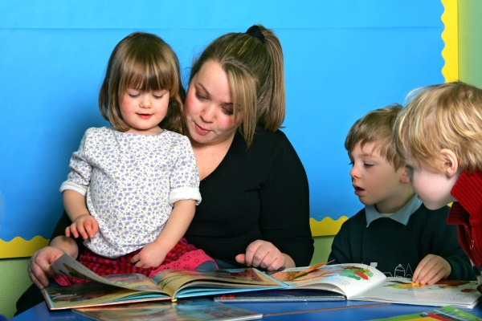
The EHCP process in more detail
You can learn about the process in more detail from:
What is an EHCP. Council for Disabled Children https://www.youtube.com/watch?v=axMjmY1-7WU&t=3s
EHCP writing for health. Council for Disabled children https://learning.councilfordisabledchildren.org.uk/class/4351/focus-health-advice
Holistic Outcomes in EHCPs | Council for Disabled Children
Education, Health and Care Plans: Examples of good practice (councilfordisabledchildren.org.uk)
Working effectively together to improve outcomes for children and young people

Slide 28
Thinking about parent carers
Being a parent of any child or young person has its challenges, but you can see from these scenarios that being the parent carer of a child or young person with SEND brings more than most.
Reflect on the following common impacts for parent carers, thinking about how this might affect their health, wellbeing and enjoyment of life. What might the knock-on impacts be for their other children?
Poor sleep
Few opportunities to socialise
Limited free time
Permanently ‘on call’
Fewer employment options
Challenges travelling
Pressure on relationships
Working effectively together to improve outcomes for children and young people

Slide 29
Lived experience of parents
Increase in mental health issues for parent and carers not recognised or addressed in holistic way by services
Parents are carers however not all will receive financial support like other carers may. Eg may not be entitled to Carer's allowance
Parents not being flagged as carers on services systems and having to repeat their personal circumstances and missing out on services offers (eg Covid vaccination) or appointments
Hidden or less obvious disabilities can be minimised or overlooked by services
Working effectively together to improve outcomes for children and young people

Slide 30
Safeguarding CYP with SEND are at greatest risk of abuse
There are several factors that contribute to disabled children and young people being at a greater risk of abuse:
Communication barriers - Children and young people with speech, language and communication needs face extra barriers when it comes to sharing their worries and concerns. Adults without training may have difficulty understanding a child communication needs. These children and young people may not recognise that they are being abused or may not know how to describe what’s happening to them.
Misunderstanding the signs of abuse - A child experiencing abuse or attempting to disclose abuse may self-harm or display inappropriate sexual behaviour or other repetitive and challenging behaviours. If this is misinterpreted as part of a child’s disability or health condition rather than an indicator of abuse, it can prevent adults from taking action.
Increased isolation - SEND children may have less contact with other people than non-disabled children. This means they have fewer people to turn to if they need help or support.
Dependency on others - Children with disabilities may have regular contact with a wide network of carers and other adults for practical assistance in daily living including personal intimate care. This can increase the opportunity for an abusive adult to be alone with a child.
Always seek guidance from your Safeguarding leads where you have concerns
Working effectively together to improve outcomes for children and young people

Slide 31
Final reflections
This module has covered a lot of information. It may seem that the world of SEND is complex and difficult to navigate sensitively, however these are the key messages from this training:
Just like safeguarding, SEND is everyone’s business
Children and young people with SEND are all individuals with their own interests, skills and abilities
Life as a child or young person with SEND, or their family member, can be tough, but small changes and positive attitudes from others can make a big difference
Understanding a child or young person’s individual needs and how to meet them helps the whole family
Working effectively together to improve outcomes for children and young people

Slide 32
Thank you for completing this training
Produced by:
North Yorkshire and York- Humber and North Yorkshire ICB
Parent Carer Voice
York Inspirational Kids
January 2023
Images credit to North Yorkshire County Council
Working effectively together to improve outcomes for children and young people

