Slide 1
Special Educational Needs and Disability (SEND) Training
Working effectively together to improve outcomes for children and young people
North Yorkshire and York
Level 1: SEND Awareness

Slide 2
Audience and objectives
This training is for all staff including non-clinical managers and staff working in healthcare services.
By the end of this training you will understand:
What SEND means
The key points of legislation regarding SEND
The potential impact of SEND on a family, and how families can be supported
Where to find more information
Working effectively together to improve outcomes for children and young people

Slide 3
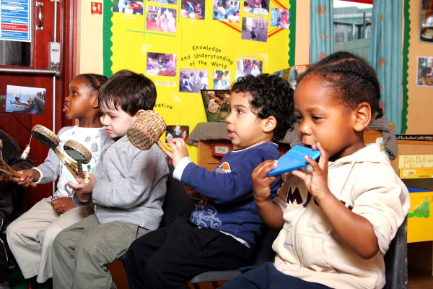
Definitions of SEN and Disability
‘Special educational needs’ and ‘disability’ are slightly different but overlapping things, although we usually group them together under the term SEND.
A child or young person has SEN if they have a learning difficulty or disability which calls for special educational provision to be made for him or her.
SEND Code of Practice
A person is disabled if they have a physical or mental impairment that has a substantial and long-term negative effect on their ability to do normal daily activities.
Equality Act 2010
Working effectively together to improve outcomes for children and young people

Slide 4
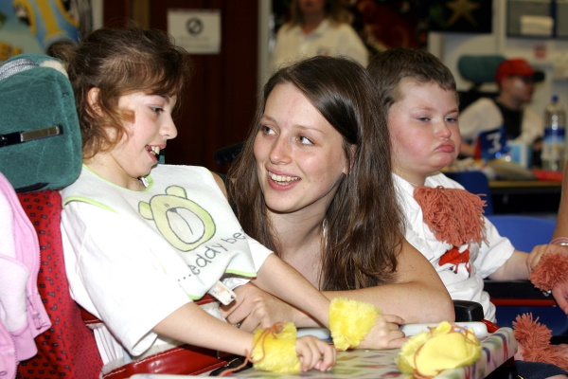
Thinking about vulnerabilities
Children and young people with SEND are classed as ‘vulnerable’, although many of them do not like this term and would rather professionals focus on their strengths.
However, it is important to recognise that these children and young people are at greater risk of poor physical and mental health, abuse, neglect, exploitation and earlier mortality rate.
Working effectively together to improve outcomes for children and young people

Slide 5
Thinking about vulnerabilities
Risk Factor
Potential Risk
Speech, language and communication needs
Being out of school/ social isolation
Difficulties recognising experiences as inappropriate/ abusive
Particular health or mental health conditions
Difficulties expressing experiences or being understood
Fewer trusted people to report to or to pick up on signs of a Learning disability
Conditions may mask signs of abuse or mistreatment
Working effectively together to improve outcomes for children and young people

Slide 6
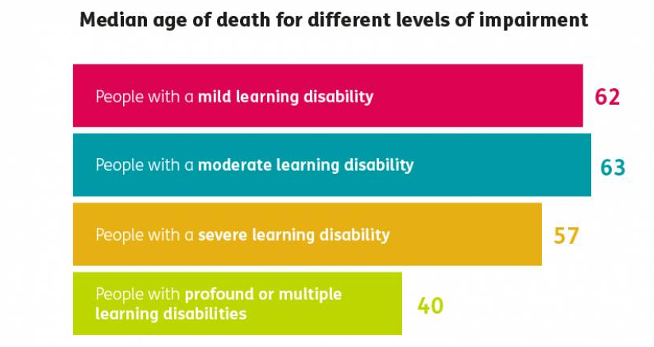
Thinking about vulnerabilities
Heslop P, Blair P, Fleming P, Hoghton M, Marriott A, Russ L.(2013) The Confidential Inquiry into premature deaths of people with learning disabilities
Working effectively together to improve outcomes for children and young people

Slide 7
Early identification and intervention
All those who work with young children should be alert to emerging difficulties and respond early. In particular, parents know their children best and it is important that all practitioners listen and understand when parents express concerns about their child’s development. They should also listen to and address any concerns raised by children themselves.
DfE and DH (2015) SEN and disability code of practice: 0-25 years, para 5.5
This is important because an early response to a concern and early identification and intervention are key to helping children to reach their potential.
Early intervention can keep a child in a mainstream school with their friends and enhance health, wellbeing and mental stability.
Working effectively together to improve outcomes for children and young people

Slide 8
Children and Families Act 2014
2014 saw the introduction of a significant piece of legislation: the Children and Families Act 2014
The Act recognised that children and young people with SEND often had poorer life outcomes including:
Physical and mental health
Employment
Leisure and community
Relationships
Financial stability
To change this, the Act requires supporting professionals to think differently about how they work with children, young people and their families:
Listen to and value children and young people’s choices and opinions
Aim high and be aspirational for children and young people
Work together
Focus on what matters most to the child or young person and their family, not what professionals think is ‘right’
Working effectively together to improve outcomes for children and young people

Slide 9
Further legislation
2015
The Special Educational Needs and Disability Code of Practice 2015 (SEND CoP 2015)
2010
2014
The Special Educational Needs and Disability Regulations 2014 (SEND Regs 2014)
Equality Act 2010
One key element of this when supporting disabled people of all ages is making reasonable adjustments to avoid disadvantage.
These Regulations supplement the framework for assessing a child or young person with special educational needs, and the procedure for making, reviewing, amending and ceasing to maintain an Educational Health and Care plan.
Details of legal requirements that you must follow without exception
The Care Act 2014 sets out in one place, local authorities' duties in relation to assessing people's needs and their eligibility for publicly funded care and support.
Working effectively together to improve outcomes for children and young people

Slide 10
Recent legislation
Long Term Plan Implementation Framework Guidance and Support Offer
Education select committee government response was published July 2020
SEND is referenced in SECTION 5.10 page 18. Systems should clearly set out how proposals for people with learning disabilities and/or autism align with their plans for mental health, special educational needs and disability (SEND), children and young people’s services and health and justice.
One recommendation is that joint CQC and Ofsted inspections should become part of an annual inspection process.
The Cross Government SEND review commissioned by the Prime Minister (publication delayed due to COVID-19)
Working effectively together to improve outcomes for children and young people

Slide 11
Inclusion
The legislation that you have looked at so far can be brought together under the term inclusion.
Becoming and being inclusive is an on-going journey which we must all take responsibility for. It is not a set list of tasks, but is an ethos which underpins how we interact with others in all contexts.
With the right support and reasonable adjustment children, young people and their families can lead fulfilled lives and supported to achieve their aspirations.
Working effectively together to improve outcomes for children and young people

Slide 12
What does this mean for the NHS?
The child or young person is at the centre of all that we do, focusing on their aspirations
Give parents or carers, and/or the child / young person opportunities to discuss their needs and aspirations, and to be involved in decisions about support
Identify children or young people with SEND at the earliest opportunity and ensure reasonable adjustments are in place
Assess and meet the needs of children and young people with SEND through the provision of appropriate support
Improve educational outcomes for children and young people with SEND through joint working from education, health and care
Integrate our plans and our services for 0-25 year olds
Working effectively together to improve outcomes for children and young people

Slide 13
Being aware of and mitigating challenges
Being a parent in any context has its highs and lows, but the family members of children and young people with SEND face more challenges than most.
The next few slides are going to look at some of these challenges.
There are two scenarios to read and reflect on.
Think about how the children, young people and family may be feeling, what could be done to support, what could be done to prevent the issues, how can you make reasonable adjustments.
Working effectively together to improve outcomes for children and young people

Slide 14
A visit to the GP
It is the half term holiday and Samir has an appointment with the GP for a rash. His sibling Alia has autism and should have been out for the day, however her support worker cancelled at the last minute. Alia found this sudden change to her plans upsetting and slept badly last night.
The family arrive at the surgery a bit late, having had to change buses as the first one was very busy, which Alia found distressing. The surgery is also busy but they find somewhere to sit. Alia spots the children’s toys and goes to play with them. A young boy nearby loudly asks his mum ‘why is that lady playing with the baby toys?’
The surgery is running late and Alia needs the toilet. She is on her period and needs her mum’s support for personal care. Her brother is too young to be left alone so has to go as well. This takes some time and while they are in the bathroom, Samir’s name is called. They do not hear it.
How would you make reasonable adjustments in your practice?
Working effectively together to improve outcomes for children and young people

Slide 15
A physio appointment
Lucas is a wheelchair user and has regular appointment with the physio, which has meant that he has had to leave school early. Some of his classmates say they are jealous that he gets regular time out of school, but Lucas feels that it makes him stand out.
Lucas and his dad are early for the appointment, but had an issue on the tram as the wheelchair spaces were taken up by pushchairs which had not been folded. Lucas’ dad found one of the owners and asked him to make space, which he did somewhat begrudgingly.
There is a new receptionist on the desk. Lucas’s parents encourage him to take as much responsibility as possible for his healthcare, so Lucas approaches the lower section of the front desk, although the receptionist is on the phone and doesn’t see him straight away. He attracts her attention and gives his name and appointment time, but has to repeat it several times as she does not understand him.
How would you ensure children, young people and families have their needs met whilst utilising health provisions? Do you check health records prior to the appointment for communication needs or ask for preferred communication methods?
Working effectively together to improve outcomes for children and young people

Slide 16
Thinking about parent carers
Being a parent of any child or young person has its challenges, but you can see from these scenarios that being the parent carer of a child or young person with SEND brings more than most.
Reflect on the following common impacts for parent carers, thinking about how this might affect their health, wellbeing and enjoyment of life. What might the knock-on impacts be for their other children?
Poor sleep
Few opportunities to socialise
Limited free time
Permanently ‘on call’
Fewer employment options
Challenges travelling
Pressure on relationships
Working effectively together to improve outcomes for children and young people

Slide 17
Lived experience of parents
Increase in mental health issues for parent and carers not recognised or addressed in holistic way by services
Parents are carers however not all will receive financial support like other carers may. Eg may not be entitled to Carer's allowance
Parents not being flagged as carers on services systems and having to repeat their personal circumstances and missing out on services offers (eg Covid vaccination) or appointments
Hidden or less obvious disabilities can be minimised or overlooked by services
Working effectively together to improve outcomes for children and young people

Slide 18
Recognising and supporting parent carers
There are many ways that being officially recognised as parent carer, as opposed to simply a parent, can be helpful. Some of these are:
Access to Carer’s Allowance
Greater awareness, flexibility and support from GPs E.g. flu vaccine, flexible appointments, greater awareness of context of health issues
Priority support from emergency services
Good partnership working and collaboration (EHCP) – reduces duplication for families. Their story should only need to be told once.
There is no one process which can register someone for all available support, so it is important that professionals understand what is available in their context and how to signpost parent carers.
Working effectively together to improve outcomes for children and young people

Slide 19
Further information locally
The local support available to professionals and families varies from area to area. However, this information should be easily accessible through your area’s Local Offer. This is a website which all local areas are required to have by law to draw together information about support and processes.
North Yorkshire https://www.northyorks.gov.uk/send-local-offer
York https://www.yor-ok.org.uk/families/Local%20Offer/sendlocaloffer
Most areas also have a Parent Carer Forum. This is group which parents can join to share experiences and concerns, find support, and take part in shaping services and processes in their local area.
North Yorkshire- Parent Carer Voice - 07396 641232 info@parentcarervoiceuk.org
www.parentcarervoiceuk.org
York Inspirational Kids 01904 780880 info@yiks.co.uk
www.yiks.co.uk
North Yorkshire SEND Hubs - North Yorkshire County Council commissions the locality SEND hubs where families and schools can access support pre and post diagnosis from multi-disciplinary specialists on a neurodiversity needs led basis. You can contact the SEND hubs at NYSENDHubs@northyorks.gov.uk
Working effectively together to improve outcomes for children and young people

Slide 20
Further information nationally
There is a lot of information available about SEND and how to support families sensitively and effectively. There are also a lot of condition-specific organisations working locally and nationally.
Some good sources of information about supporting families and understanding SEND generally are:
The Council for Disabled Children
Contact
Mencap
National Network of Parent Carer Forums
Working effectively together to improve outcomes for children and young people

Slide 21
Final reflections
This module has covered a lot of information. It may seem that the world of SEND is complex and difficult to navigate sensitively, however these are the key messages from this training:
Just like safeguarding, SEND is everyone’s business
Children and young people with SEND are all individuals with their own interests, skills and abilities
Life as a child or young person with SEND, or their family member, can be tough, but small changes and positive attitudes from others can make a big difference
Understanding a child or young person’s individual needs and how to meet them helps the whole family
Working effectively together to improve outcomes for children and young people

Slide 22
Thank you for completing this training
Produced by:
North Yorkshire and York – Humber and North Yorkshire ICB
Parent Carer Voice
York Inspirational Kids
August 2022
Images credit to North Yorkshire County Council
Working effectively together to improve outcomes for children and young people

